Slide 1

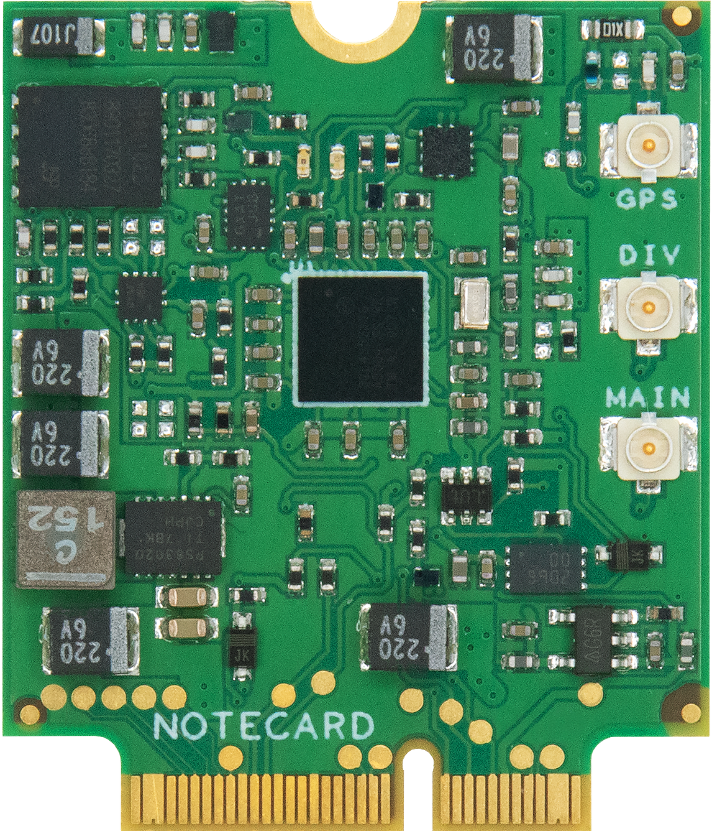
Machine Learning from Cloud to the Internet of Things

Slide 2
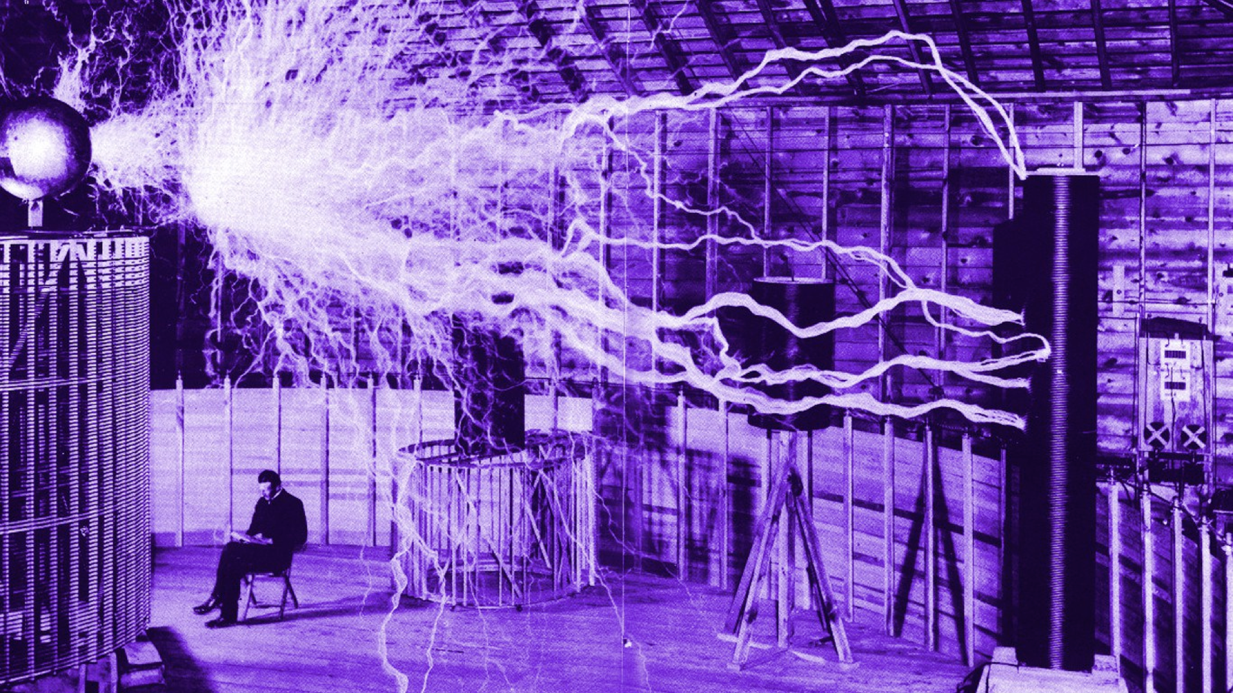

Slide 3
Agenda
Day 1
Welcome
Unit 1 – ML and Deep Learning Basics
AL, ML and DL Demystified
Lab 1 – ML with Python and TensorFlow
DL and CNNs
ML and Cloud Computing
Lab 2 – Build a CNN for Image Recognition
Challenges with Cloud-based ML
Lunch
Unit 2 – Introducing the IoT
The IoT is Dead, Long Live the Internet
Introducing Developer-Friendly Cellular with Blues
Lab 1 - Getting Started with the Notecard
Working with Sensors and Actuators
Lab 2 – Collecting Sensor Data
Day 2
Welcome
Unit 3 – ML and the IoT
Why ML and the IoT
ML at the edge with MCUs
Lab 1 – Building a Linear Regression Model with TFLite
Accelerating Edge ML with Edge Impulse
Lab 2 – Building a Gesture Recognition System for Edge Impulse
Lunch
Unit 4 – The future of ML and the IoT
Unit 5 - Hacking Challenge and Free Exploration
Project Share and Wrap-Up

Slide 4
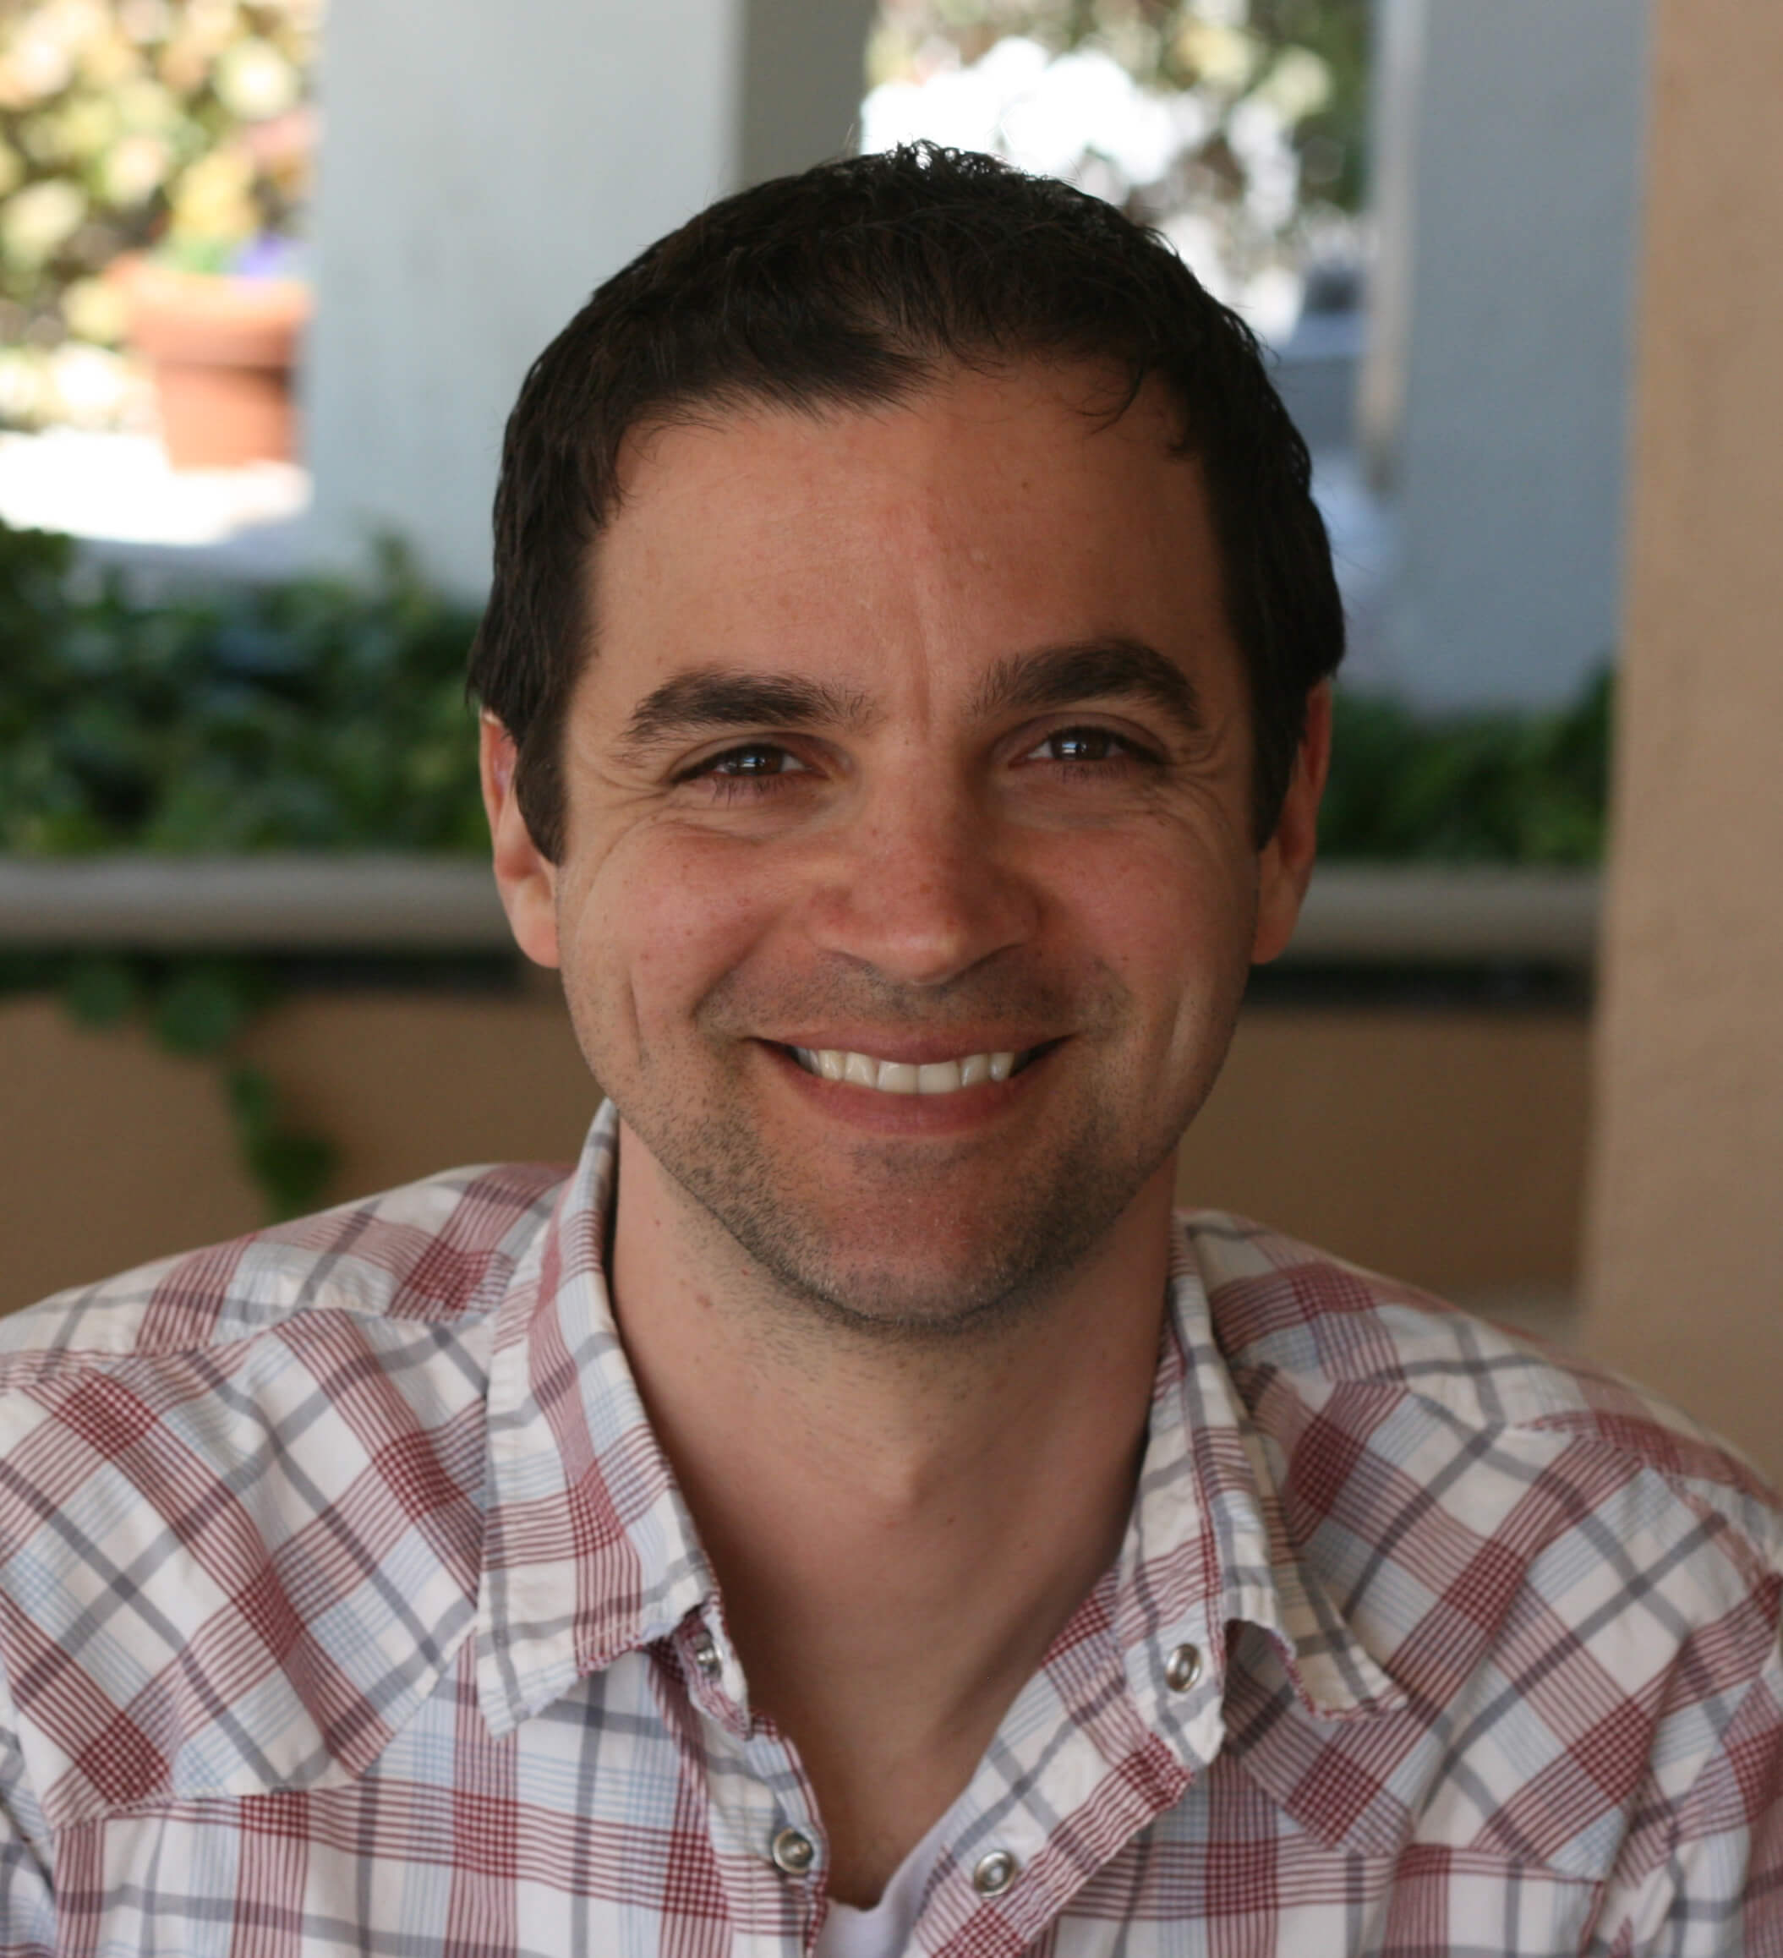
Rob Lauer
Director of Developer Relations @ Blues Wireless
@RobLauer

Slide 5
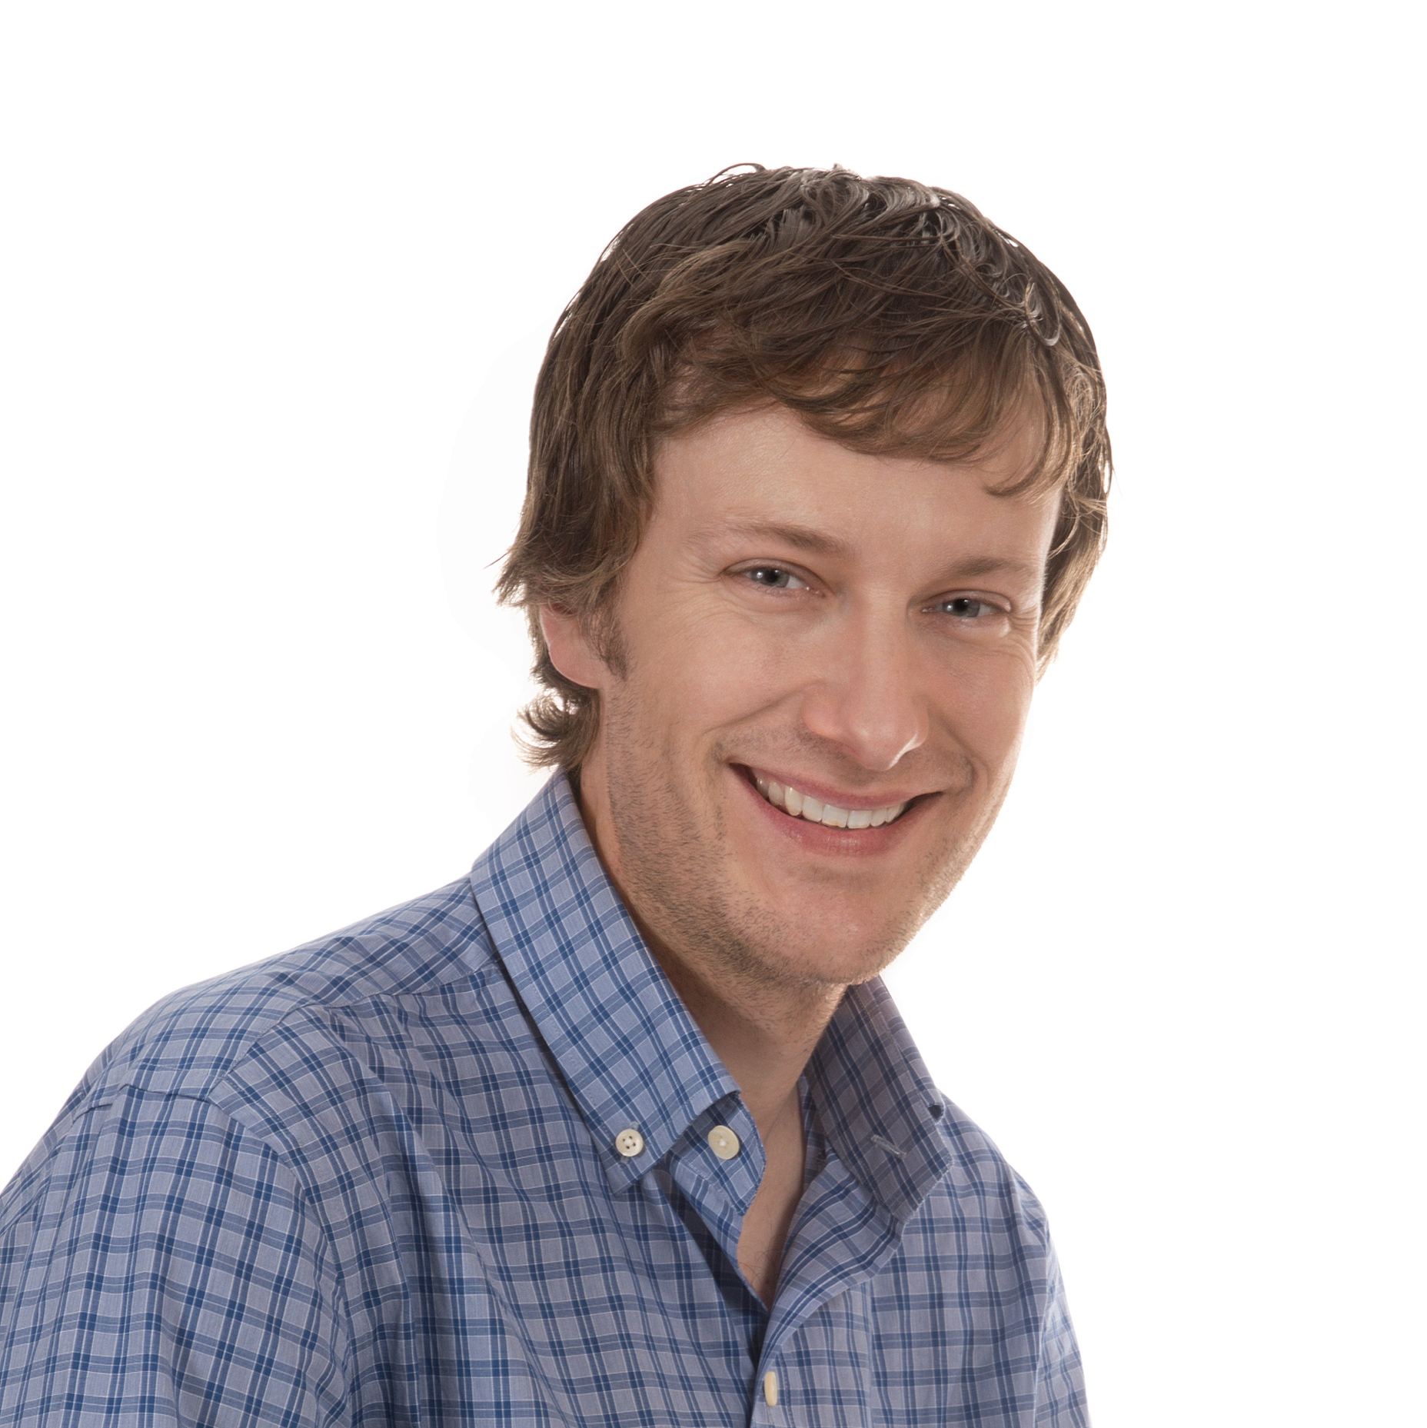
Brandon Satrom
VP of Experience Engineering @ Blues Wireless
@BrandonSatrom

Slide 6
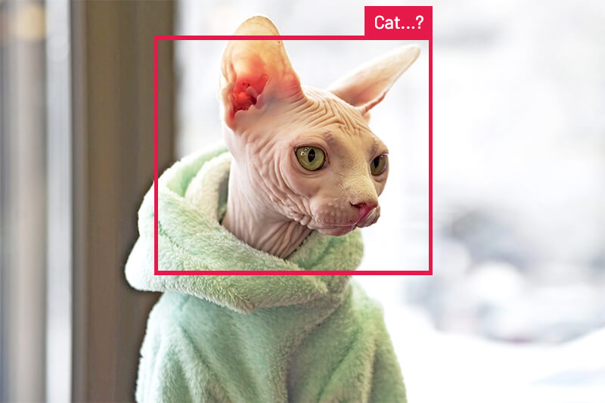

Slide 7

Your Turn!
Your Name
What you do
Experience with AI, ML and/or IoT development
Your Goals for the Workshop

